Slide 1

Neo4j: A Graph Database
Knowledge-based System Engineering
Laboratorium Manajemen Cerdas Informasi
Intelligent Information Management Lab

Slide 2
Why Graph Database?
Today’s data is highly connected (e.g., social networks, recommendations, fraud detection).
Traditional RDBMS struggle with complex joins and relationship-heavy queries.
Graph databases natively store relationships → fast traversal, intuitive modeling.
Used by: Facebook, LinkedIn, Netflix, eBay, NASA.
💡 “In knowledge representation, the relationship is as important as the entity.”

Slide 3
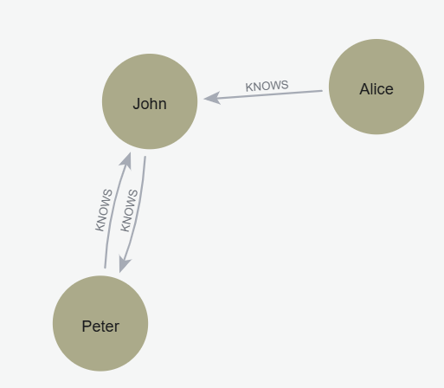
Example: Social Connections
Question:
How would you represent “Alice knows John, and John knows Peter”?
In a relational model → multiple tables and joins.
In a graph model → intuitive nodes and relationships.

Slide 4
What is Graph Database
A graph database is a data management system that stores:
Nodes: entities (like people, movies, companies)
Relationships: connections between nodes
Properties: key-value attributes of nodes or relationships
Labels: define categories of nodes

Slide 5
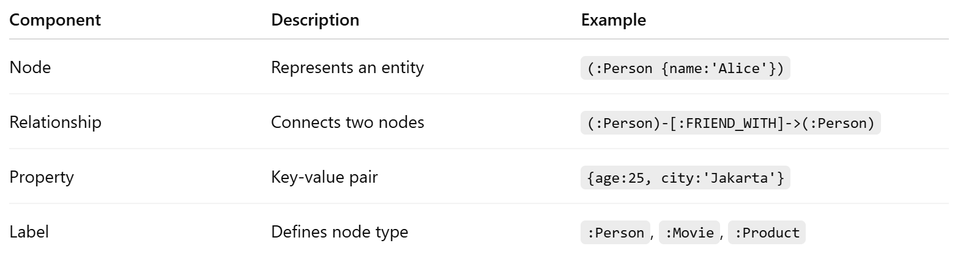
Components of a Graph (Neo4j Model)

Slide 6
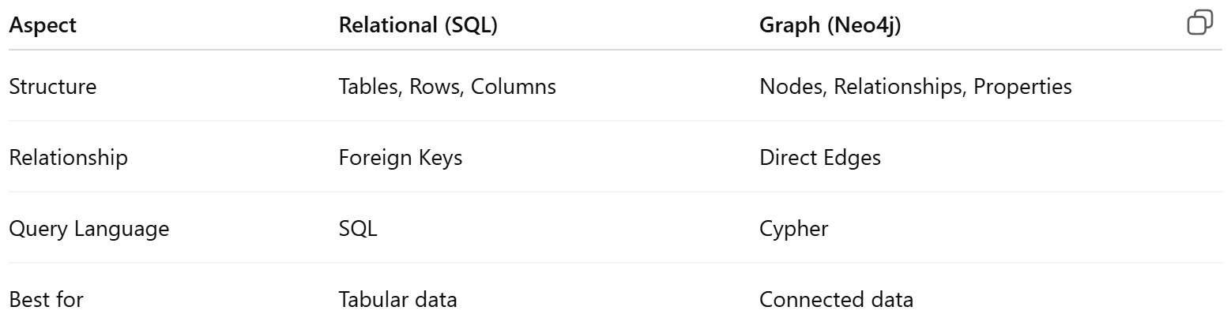
Graph vs Relational Database

Slide 7

Neo4j Overview
Developed by Neo4j Inc., first released in 2007.
Written in Java, supports property graph model.
Offers Neo4j Desktop, Neo4j Aura Cloud, and Neo4j Browser for visualization.
Query language: Cypher.
Used by: NASA, eBay, Walmart, Adobe for recommendation engines, fraud detection, knowledge graphs

Slide 8
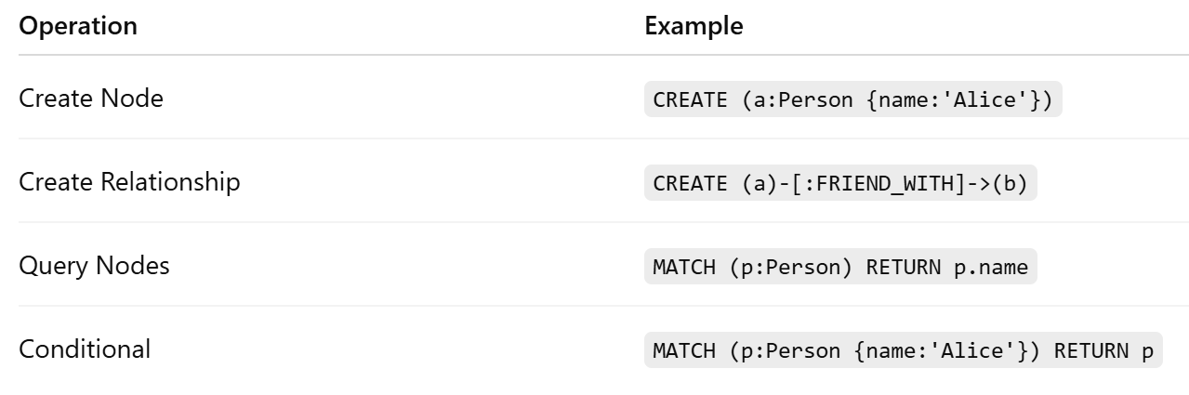
Cypher Query Language Basics
Cypher is declarative, similar to SQL, but uses patterns.

Slide 9
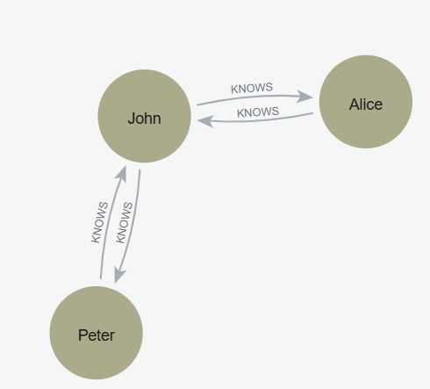
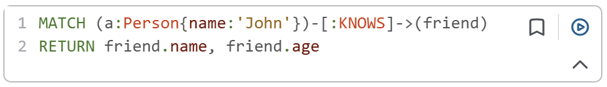
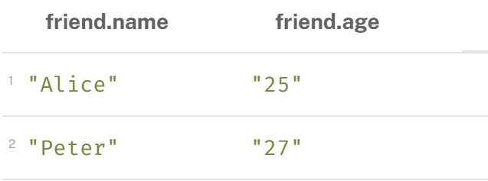
Pattern Matching
Cypher matches graph patterns visually.
Example:
Result: All pairs of friends

Slide 10
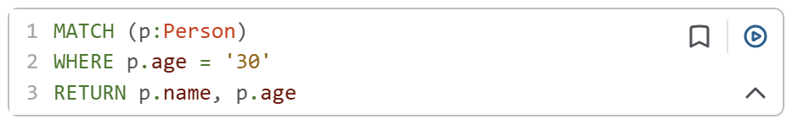
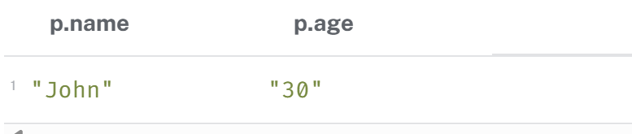
Filtering and Constraints
Use WHERE for filtering
Result:

Slide 11
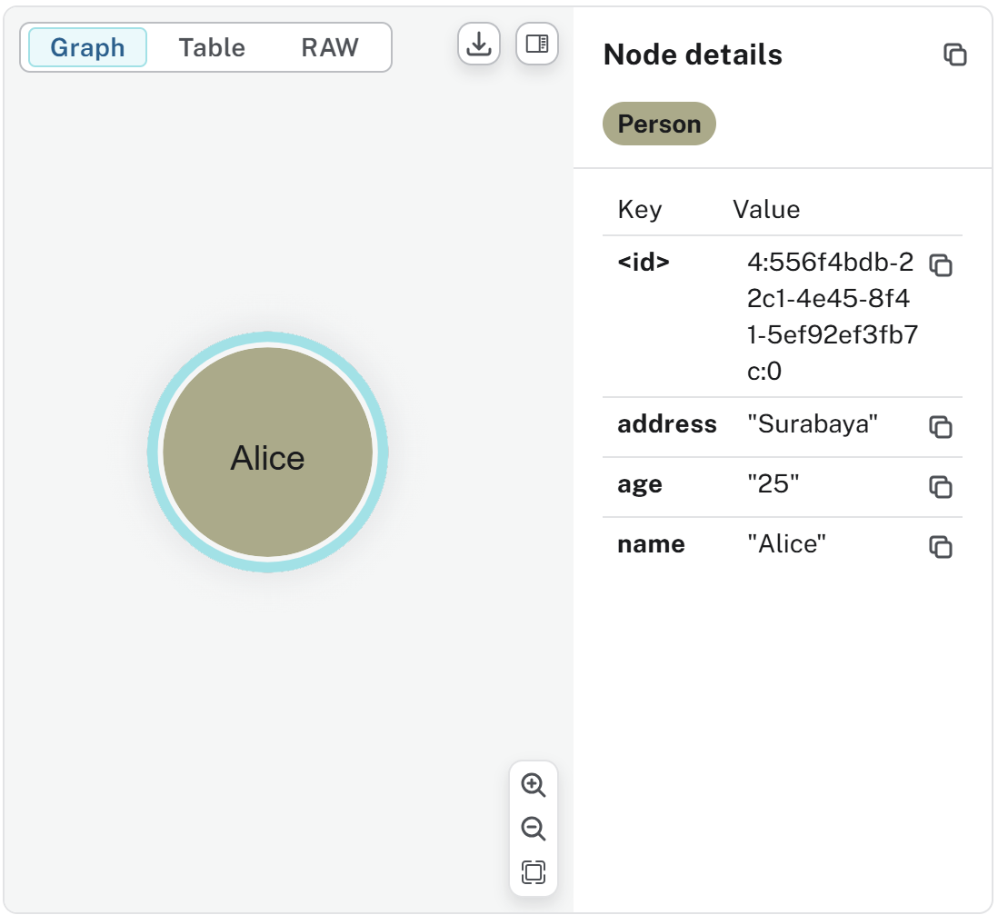
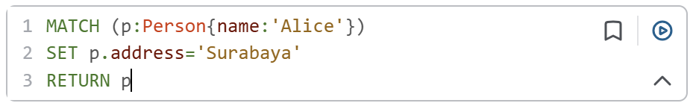
Setting Property
Using SET for adding property

Slide 12
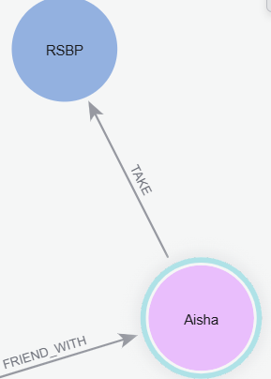
Setting Relationship
MATCH (a:STUDENT {name:'Aisha'})
MATCH (c:COURSE {cname:'RSBP'})
CREATE (a)-[:TAKE]->(c)

Slide 13
Delete and Detach
DELETE:
  The DELETE clause is used to remove a node from the graph.
  Crucially, DELETE cannot be used on a node that still has relationships connected to it. If you attempt to DELETE a node with existing relationships, Neo4j will raise an error, adhering to its ACID compliance and ensuring data integrity.
DETACH DELETE:
  The DETACH DELETE clause is a more convenient and efficient way to delete a node and all its connected relationships in a single operation.
  When you use DETACH DELETE on a node, Neo4j automatically handles the deletion of all incoming and outgoing relationships connected to that node before deleting the node itself.

Slide 14
Case Study: Simple Social Network
Goal: Model a small network of people and interests.
Nodes:
Person: Alice, Bob, Charlie
Interest: Music, Sports
Relationships:
(:Person)-[:FRIEND_WITH]->(:Person)
(:Person)-[:LIKES]->(:Interest)

Slide 15
Cypher Implementation Example
CREATE (alice:Person {name:'Alice'})
CREATE (bob:Person {name:'Bob'})
CREATE (charlie:Person {name:'Charlie'})
CREATE (music:Interest {name:'Music'})
CREATE (sports:Interest {name:'Sports'})
CREATE (alice)-[:FRIEND_WITH]->(bob)
CREATE (bob)-[:FRIEND_WITH]->(charlie)
CREATE (alice)-[:LIKES]->(music)
CREATE (charlie)-[:LIKES]->(sports);

Slide 16
Query Examples
// 1. Find all friends of Alice
MATCH (a:Person {name:'Alice'})-[:FRIEND_WITH]->(f)
RETURN f.name;
// 2. Find who likes the same interest as Bob
MATCH (p:Person)-[:LIKES]->(i)<-[:LIKES]-(b:Person {name:'Bob'})
RETURN p.name, i.name;

Slide 17
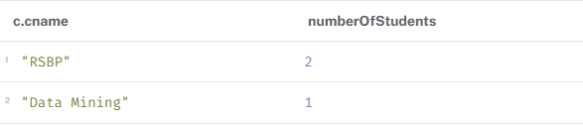
Aggregation
MATCH (s:STUDENT)-[:TAKE]->(c:COURSE)
RETURN c.cname, count(s) AS numberOfStudents
ORDER BY numberOfStudents DESC

Slide 18
Neo4j Graph Data Science (GDS)
Neo4j Graph Data Science (GDS) is a specialized software library designed to help data scientists and developers extract predictive insights and run machine learning models on top of connected graph data.
  Unlike standard database queries that retrieve specific data points, GDS analyzes the global topology and relationships across an entire network
Primary Algorithm Categories
Community Detection: Grouping nodes based on cluster density or modularity (e.g., Louvain, Label Propagation) to uncover fraud rings or customer segments
Centrality: Calculating the systemic importance or influence of specific nodes in the network (e.g., PageRank, Betweenness Centrality)
Similarity: Evaluating how similar pairs of nodes are based on their properties or shared neighbors (e.g., Jaccard, Cosine Similarity)
Pathfinding & Search: Finding optimal routes or assessing network availability between endpoints (e.g., Dijkstra, A*)
Link Prediction: Determining the mathematical likelihood that two currently disconnected nodes will form a relationship in the future

Slide 19
Example
Create Nodes
Create Friendship relationship
CREATE (a:User {name:'Aisha'}),
(b:User {name:'Budi'}),
(c:User {name:'Citra'}),
(d:User {name:'Deni'}),
(e:User {name:'Eka'}),
(f:User {name:'Fajar'}),
(g:User {name:'Gina'}),
(h:User {name:'Hadi'});
MATCH (a:User {name:'Aisha'}),
(b:User {name:'Budi’}),
(c:User {name:'Citra’}),
(d:User {name:'Deni'}),
(e:User {name:'Eka'}),
(f:User {name:'Fajar'}),
(g:User {name:'Gina'}),
(h:User {name:'Hadi’})
CREATE (a)-[:FRIEND]->(b),
(a)-[:FRIEND]->(c),
(b)-[:FRIEND]->(c),
(b)-[:FRIEND]->(d),
(c)-[:FRIEND]->(d),
(d)-[:FRIEND]->(e),
(e)-[:FRIEND]->(f),
(f)-[:FRIEND]->(g),
(g)-[:FRIEND]->(h),
(e)-[:FRIEND]->(h);

Slide 20
Community Detection: Louvain Algorithm
Louvain detects communities by optimizing modularity.
Modularity measures how strongly a network is divided into communities compared with what would be expected in a randomized network
1. create an in-memory graph projection
2. Louvain algorithm
CALL gds.graph.project(
'socialGraph', 'User’,
{ FRIEND:
{ orientation: 'UNDIRECTED’
}
}
);
CALL gds.louvain.stream('socialGraph’)
YIELD nodeId, communityId
RETURN
gds.util.asNode(nodeId).name AS User,
communityId
ORDER BY communityId, User;

Slide 21
Degree Centrality
Degree centrality measures the number of direct connections a node has.
A node with a high degree is an influential node
CALL gds.degree.stream('socialGraph')
YIELD nodeId, score
RETURN
gds.util.asNode(nodeId).name AS User,
score AS Degree
ORDER BY Degree DESC;

Slide 22
Betwenness Centrality
Betweenness centrality identifies nodes that frequently lie on shortest paths between other nodes.
A node that connects two separate groups may have high betweenness centrality, even if that node does not have the highest number of connection.
CALL gds.betweenness.stream('socialGraph')
YIELD nodeId, score
RETURN
gds.util.asNode(nodeId).name AS User,
score AS Betweenness
ORDER BY Betweenness DESC;

Slide 23
Similarity: Jaccard Similarity
Objective: Determine how similar two nodes are based on their properties or network connections.
  In social networks, two users may be considered similar if they have many mutual friends.
CALL gds.nodeSimilarity.stream('socialGraph', {
topK: 5,
similarityCutoff: 0.1
})
YIELD node1, node2, similarity
RETURN
gds.util.asNode(node1).name AS User1,
gds.util.asNode(node2).name AS User2,
similarity
ORDER BY similarity DESC;

Slide 24
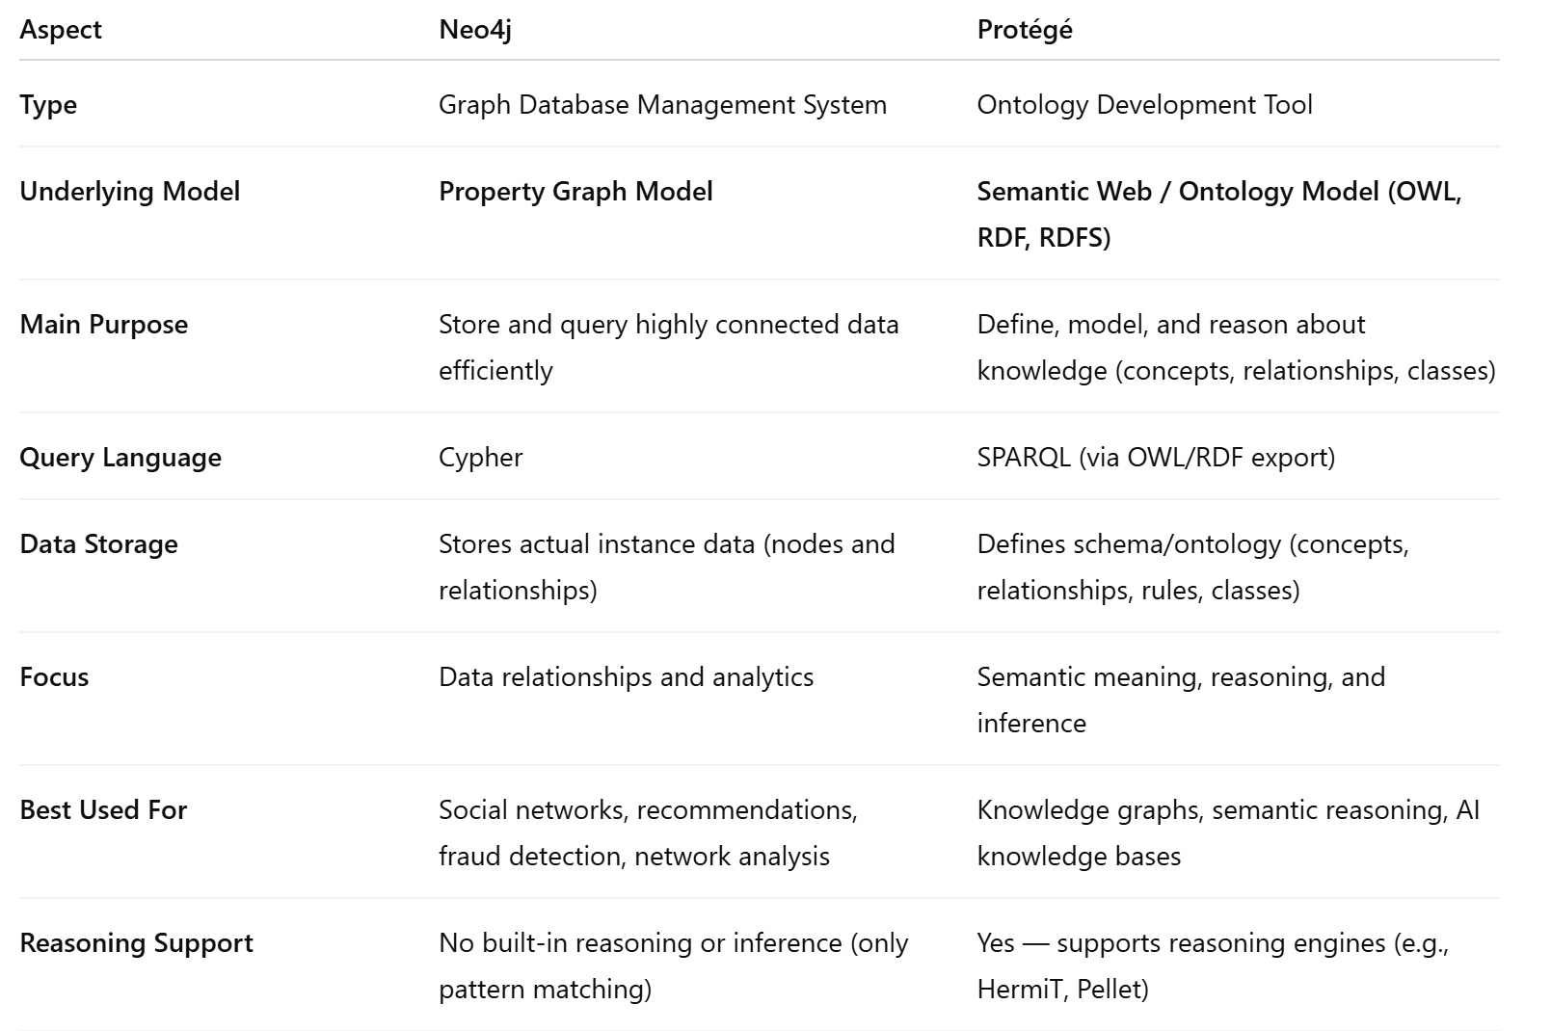
Neo4j vs Protege

Slide 25
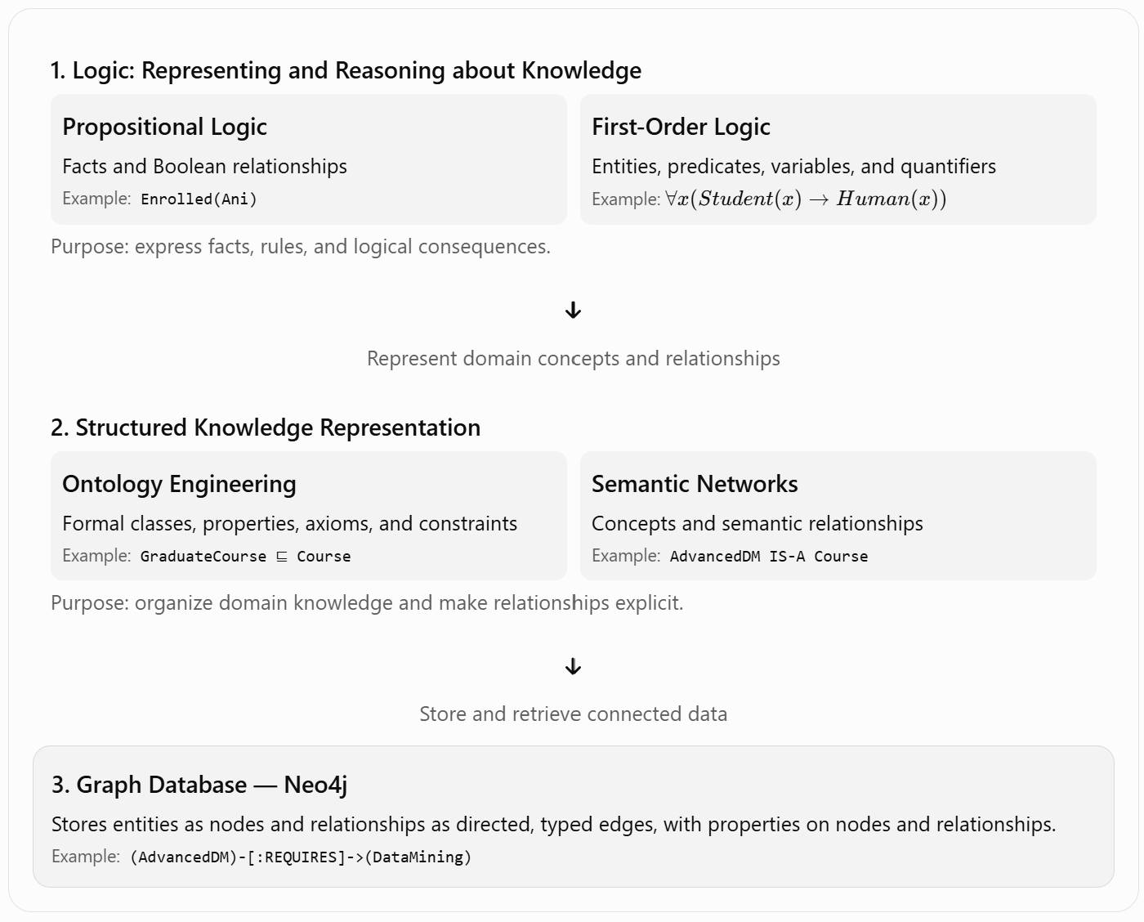
The Knowledge Representation Landscape

Slide 26
Comparison of Five Approaches
Approach | What it represents well | Main role
Propositional Logic | Atomic facts and Boolean rules | Logical reasoning
First-Order Logic | Entities, relations, variables, quantifiers | General rules and inference
Ontology | Classes, properties, axioms, constraints | Formal domain semantics
Semantic Network | Concepts and labeled relationships | Visual knowledge representation
Graph Database | Connected entities, relationships, and properties | Persistent storage and graph queries

Slide 27
Further Learning & Resources
Official Neo4j Docs: https://neo4j.com/docs/
Neo4j GraphAcademy: Free courses (https://graphacademy.neo4j.com )
Knowledge Graph: https://neo4j.com/use-cases/knowledge-graph/
Cypher Manual: https://neo4j.com/docs/cypher-refcard
Books:
  Graph Databases by Robinson, Webber, Eifrem
  Learning Neo4j

Slide 28
Exercise 1
Create the graph DB using these statements:
Aisha and Budi are students.
Citra is also a student.
Dr. Sari and Dr Andi are lecturers.
Database Systems, Data Mining, and Knowledge-Based Systems are courses.
Aisha takes Database Systems and Data Mining.
Budi takes Database Systems and Knowledge-Based Systems.
Citra takes Data Mining and Knowledge-Based Systems.
Dr. Sari teaches Database Systems and Data Mining.
Dr. Andi teaches Knowledge-Based Systems.
Knowledge-Based Systems requires Database Systems.
Data Mining requires Statistics.
Knowledge-Based Systems requires Data Structures.
Then, create cypher queries to:
Find all available courses.
Find all courses taken by Aisha.
Find all students taking Database Systems.
Find all courses taught by Dr Sari.
Find the lecturer teaching Knowledge-Based Systems.
Find the prerequisites of Data Mining.
Find all courses with 3 credits.
Display all students and the courses they take.
How many students take each course?
How many courses does each lecturer teach?

Slide 29
Exercise 2
Import twitch graph data from: https://github.com/neo4j-graph-examples/twitch
Do graph analysis using GDS for
  Community detection
  Find the most popular streamer or user
  Find similar streamers (with similar audiences)

Slide 30
Thank you

